Slide 1










AMAZON
CUSTOMER REVIEWS SENTIMENT ANALYSIS
HOW SENTIMENT AFFECTS PRODUCT RATING

Slide 2
TABLE OF CONTENTS
01
02
03
IMPLICATIONS
DATA
DATA ANALYSIS
Implications for Stakeholders & Ethical, Legal, Societal Implications
Tractable Data &
Data Retrieval
EDA, Modeling & Results

Slide 3




IMPLICATIONS
FOR STAKEHOLDERS
BUSINESSES AND E-COMMERCE PLATFORMS
DATA SCIENTISTS AND ANALYSTS
Product Development & Quality Control
Customer Experience Optimization
Marketing & Advertising
Improvement in Analytical Tools & Techniques
Research Contributions
CONSUMERS
PRODUCT MANUFACTURERS AND SUPPLIERS
Enhanced Decision-Making
User Experience
Brand Reputation Management
Supplier Adjustments

Slide 4



ETHICAL, LEGAL, SOCIETAL IMPLICATIONS
ETHICAL
LEGAL
SOCIETAL
Bias in Sentiment Analysis
Transparency and Accountability
Privacy Concerns
Influence on Consumer Behavior
Data Ownership and Consent
Product Liability and Legal Claims
Misrepresentation and Consumer Protection
Consumer Trust
Impact on Small Businesses and Local Sellers
Social Responsibility
Psychological Impact on Consumers

Slide 5




TRACTABLE DATA
The dataset contains over 34,000 consumer reviews for various Amazon products. The data is provided by Datafiniti’s Product Database.
Data Storage and Format:
Structured in a CSV file format
Column Names: id, reviews.text, reviews.rating, reviews.date, product_name, product_category, manufacturer, …
Data Types: Both categorical and numerical.

Slide 6



DATA RETRIEVAL
Data Source: Kaggle
Amazon Customer Reviews Dataset
Selection Process
Availability of Relevant Attributes
Completeness and Quality of Data
Time Frame of Reviews
Variety of Product Categories

Slide 7


DATA CLEANING
TEXT PREPROCESSING
Keep only the necessary columns
reviews.text, reviews.rating
Drop rows with missing values
Convert reviews.rating to integer type
Convert text to lowercase
Remove special characters and digits
Remove single characters
Remove multiple spaces

Slide 8
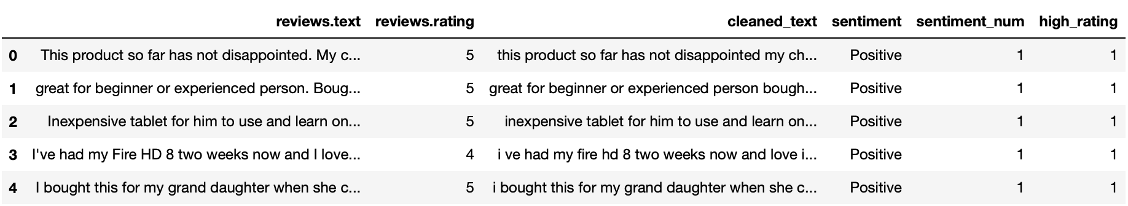
SENTIMENT ANALYSIS
Using TextBlob

Slide 9
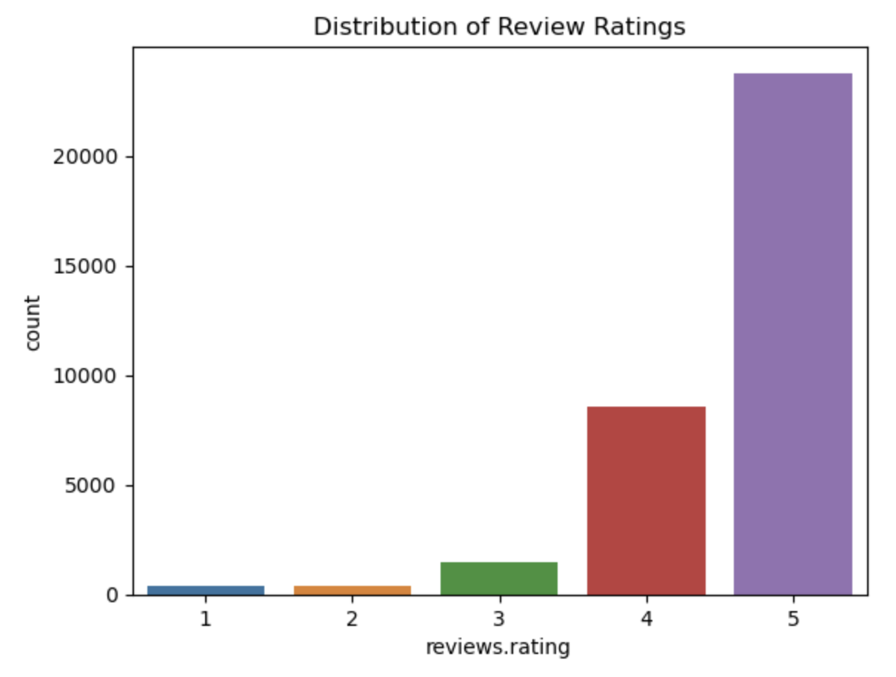
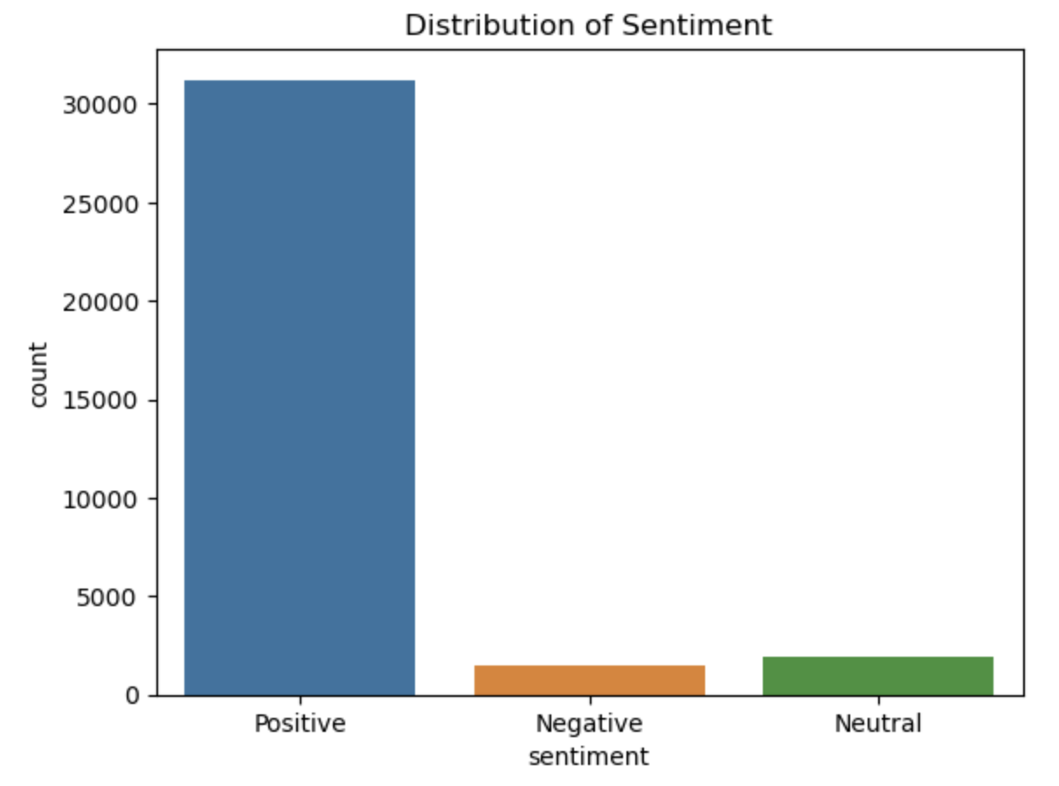
EXPLORATORY DATA ANALYSIS

Slide 10
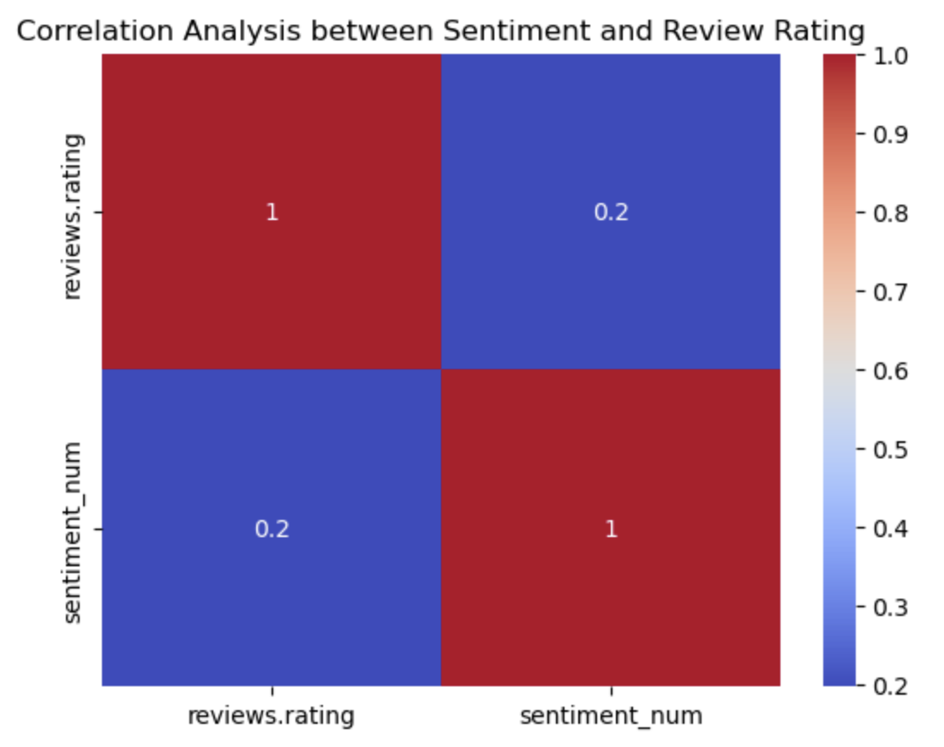
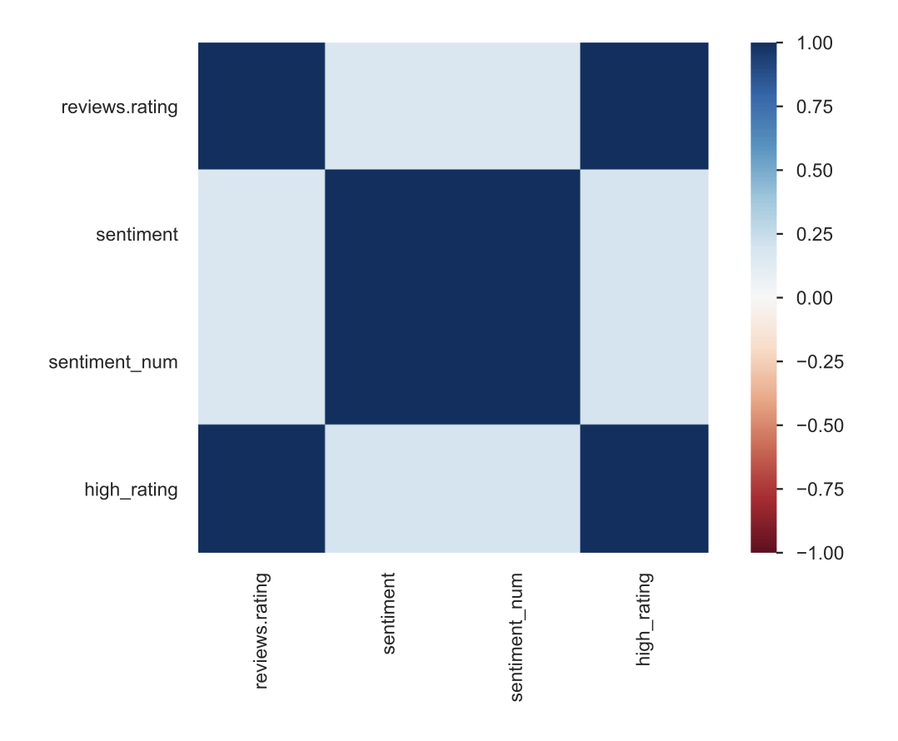
EXPLORATORY DATA ANALYSIS

Slide 11

EXPLORATORY DATA ANALYSIS

Slide 12
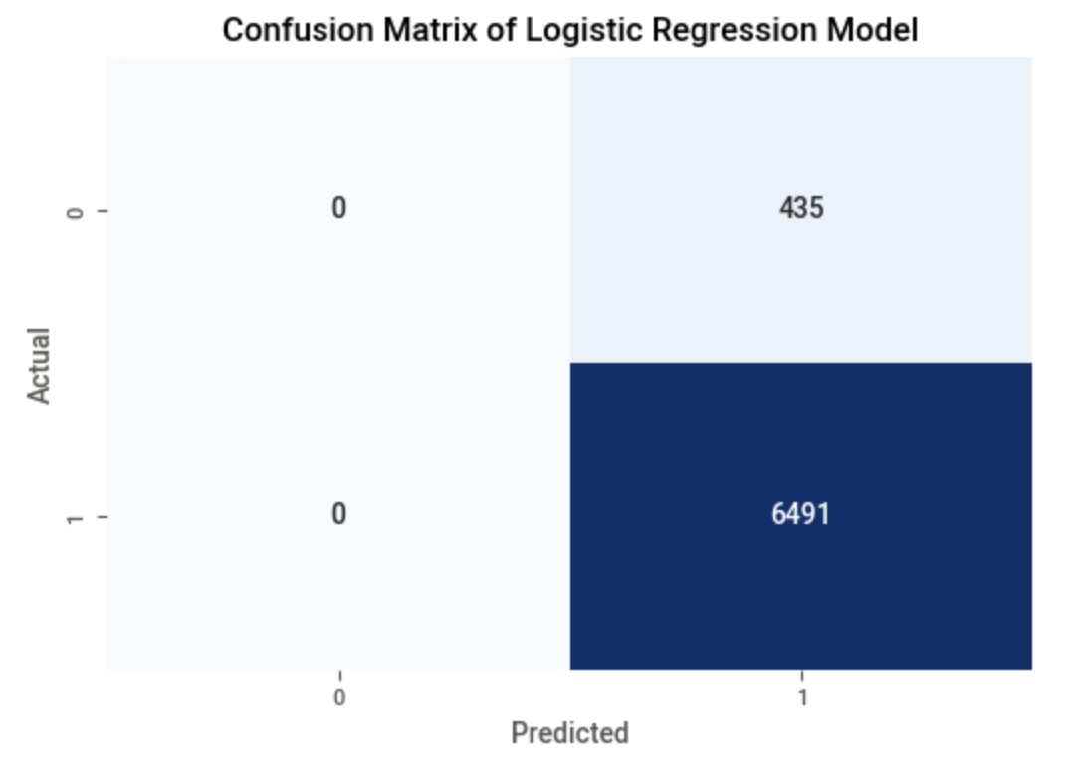
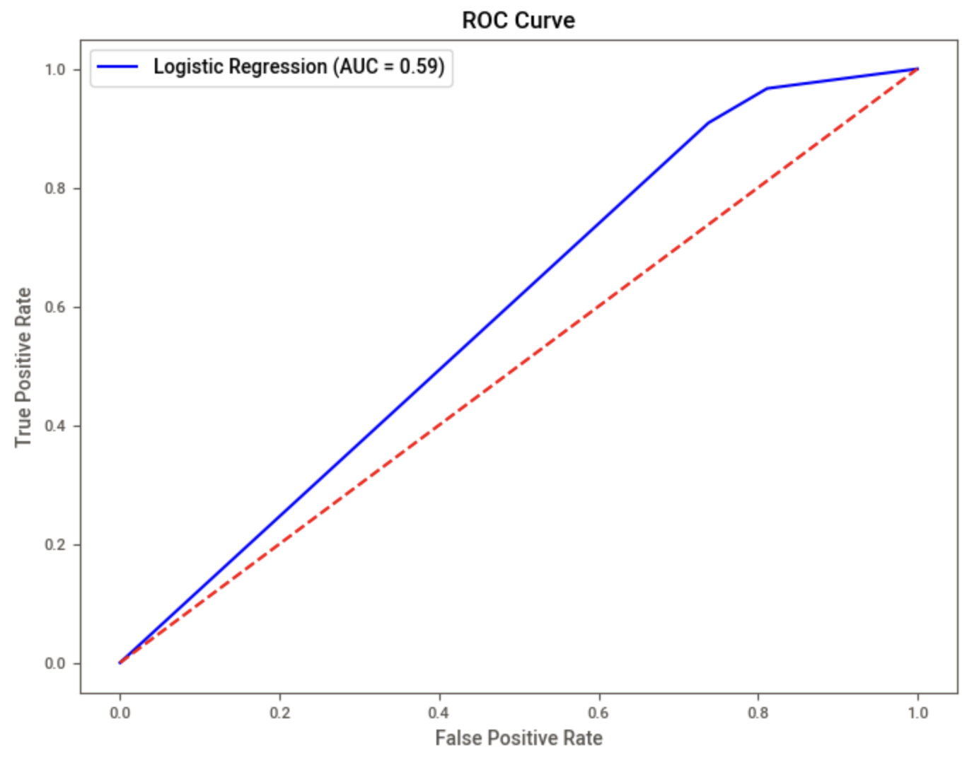
MODELING
Logistic Regression

Slide 13
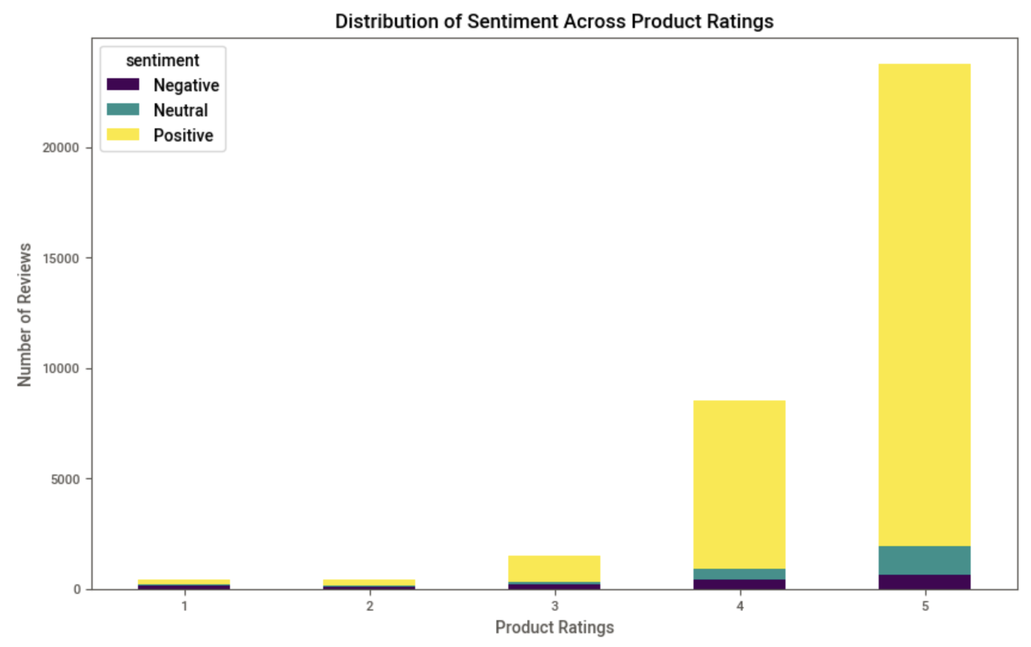
VISUALIZATION

Slide 14

THANK YOU!

